Slide 1

Theater Tech Rider

Slide 2











Welcome
Thank you for considering hosting an event in our theater! Our theater is perfect for any type of event you might be hosting. We have hosted many events from concerts, dance recitals, company sales rallies, graduations, and much more.
Our theater is located right in the heart of the Disneyland Hotel Resort Area, we have many hotels right in front of our venue such as the Embassy Suites, Marriott, and many more. Our location is perfect because it is secured and if you are having any out-of-town guests or artists then you may book their stay at any of the hotels right around us!
Our goal it’s to make your booking experience easy and help you plan your event from beginning to end! Our theater is different than other venues near us! One of the beauties of The Grand Theater is that there are no bad seats in our theater, anywhere you sit you get a great view of the stage.
If you are having a concert, all guests will enjoy amazing drinks and food that is sold at our snacks and bars! If your event is more corporate, then we can provide your team with snacks and soft drinks! Just ask us how!
Please review our tech rider which has lots of helpful information and feel free to let us know if you need anything else or may answer any questions you may have. We are here to help you!
I look forward to meeting and working with you!

Slide 3
Lighting, Audio & Backstage Info
Stage Dimensions:
80x40
Backstage Accommodations
1- Artist dressing room “A” (w/shower)
2-Large dressing room “B” & C (w/shower), with dressing room “B” having an additional private 10x10 room
within all dressing rooms are stage level.
House Audio
6 QSC KW153 (3per side) Ground Stack
4 QSC KW181 (2per side) Ground Stack
1 LS9 32ch Digital mixer
2 Shure Wireless Mics Beta58 handheld
1 Tech for Audio
House Lighting
4 Elation FLX Hybrid Moving Beam/Spots
6 Elation ZW37 Led Wash Moving heads
5 ETC Source Four Leckos
1 Hedge Hog4 Console
1 Hazer
1 Tech for Lighting
Not Included:
Wireless Mics available upon request, Risers Available
Please let us know your specifications, Backline available upon request

Slide 4
Loading & Unloading
Loading and Unloading of Equipment / Show Production:
South loading area will accommodate (2) trucks (s/e door is double door, s/w door is 36" wide)
There is a loading restriction on the south side with no loading/unloading from 8pm to 8am
Backstage Important Information: First and Foremost, our backstage security procedures at TGT have changed. The following apply to your traveling party:
TGT only honors passes approved by the Director of Operations. We will not honor your tour passes/laminates unless approved by the DOO.
Passes are given to artists, crew, and artists entourage to ensure that only authorized people have access to backstage.
ABSOLUTELY NO "HANGING OUT" IN THE BACKSTAGE WILL BE TOLERATED, as this poses a safety hazard for guests and security issues with equipment.
If a "meet and greet" is part of your show, must be approved and coordinated prior to event, please contact your event.
Coordinator to prearranged a location for your meet and greet / picture taking with your artist(s).
There will be a lock down one hour prior to the opening of doors. If anyone should exit the building during this time, they will be wanded or searched on re-entry.
No outside Liquor allowed at The Grand Theater. If your show requires catering and or liquor, please coordinate with DOO prior to event.

Slide 5
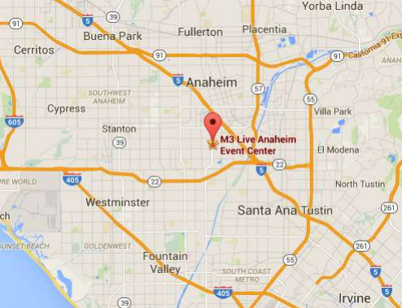
Parking & Directions
Parking:
TGT will give at no charge complimentary free 20 self parking tickets for you and your staff.
All staff and or workers parking at The Grand Theater will need a parking pass.
Traveling North on I-5 :
Take the Chapman exit and turn left.
Proceed on Chapman Ave for approximately 1.5 miles to Harbor Boulevard and turn right (North).
Proceed approximately 0.25 miles on Harbor Boulevard and The Grand Theater and Parking will be on your right.
Traveling North on I-5 :
Take the Harbor Blvd exit and turn right.
Proceed on Harbor Blvd. for approximately 1.5 miles (South).
Pass traffic signal at Wilken Way and The Grand Theater and Parking will be on your left. (turn left at traffic signal "Shopping Center").

Slide 6
Theater Add’l Info
Capacity:
Our Theater has a capacity of 964 seating
Seating is divided into two sections Upper levels and the Pit Area.
These two sections are divided by a walkway
There are 4 Sections: 100, 200, 300 and 400
The lower part of the theater from Row A through E has two sections Pit 1 or Pit 2
Each Row has a letter and a Seat number
Row F in Sections 100 & 300 has handicap seats.

Slide 7
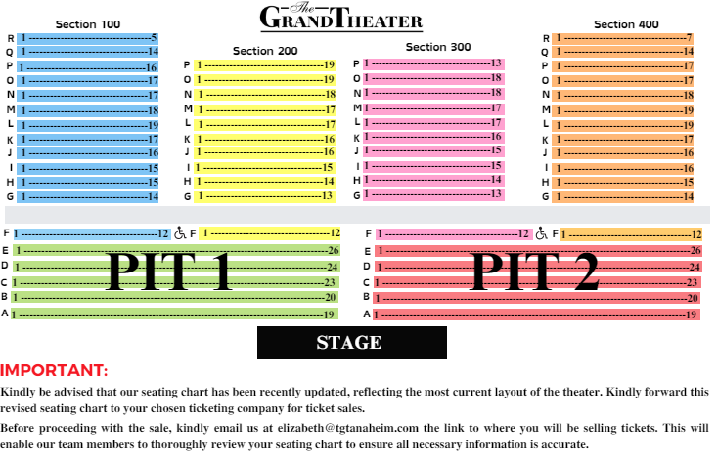
Seating Chart

Slide 8
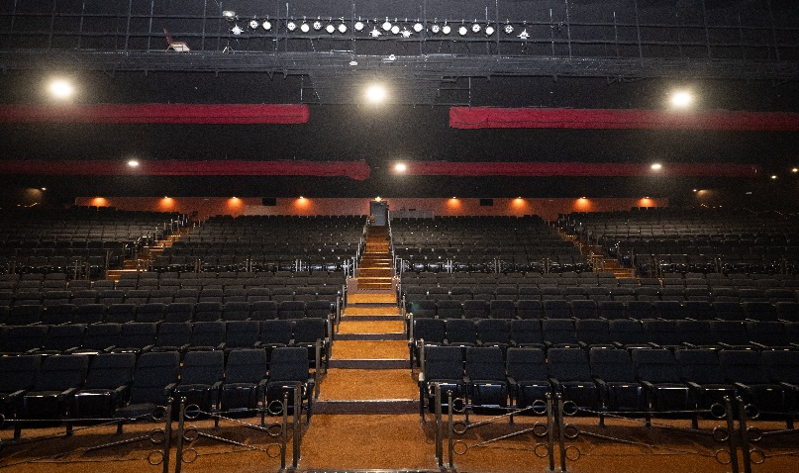
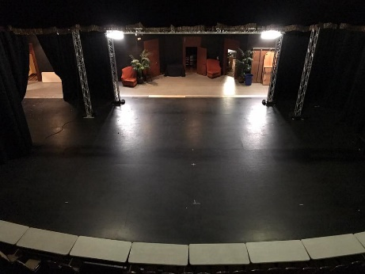
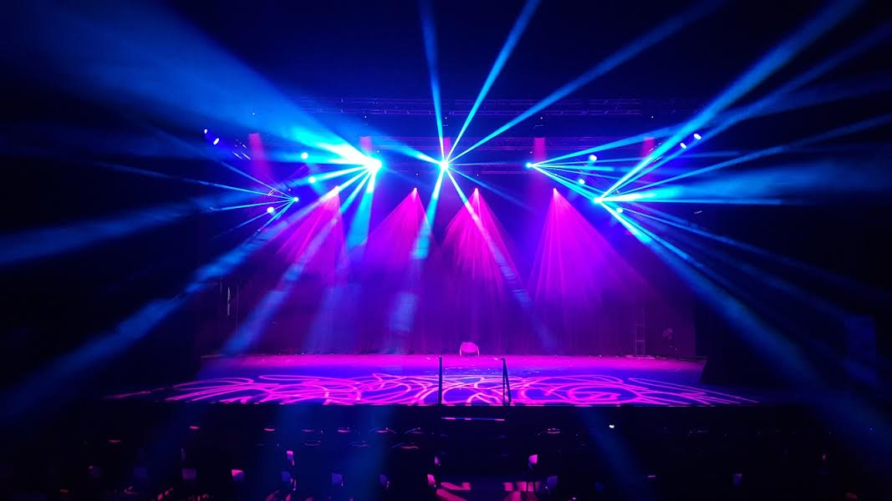
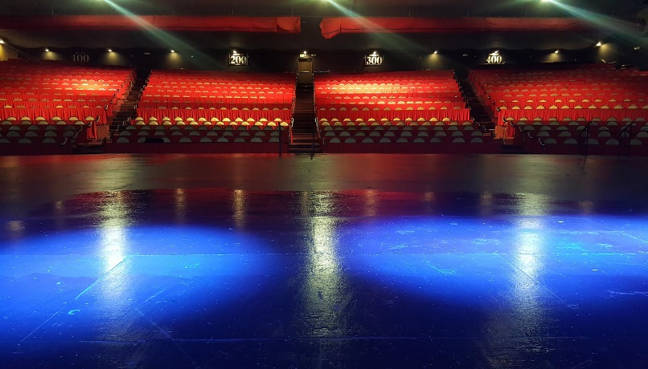
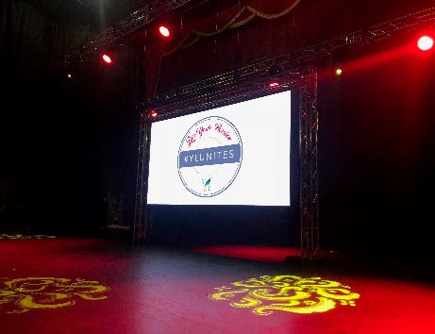
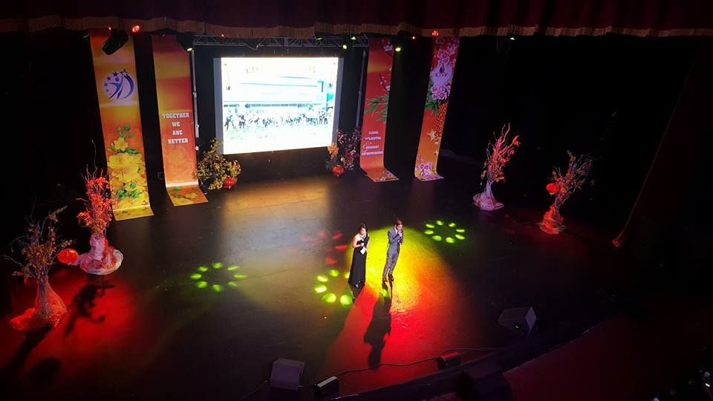
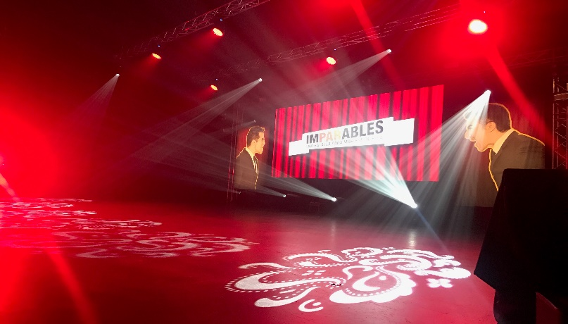
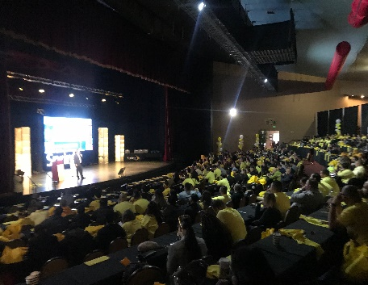
Pictures

Slide 9
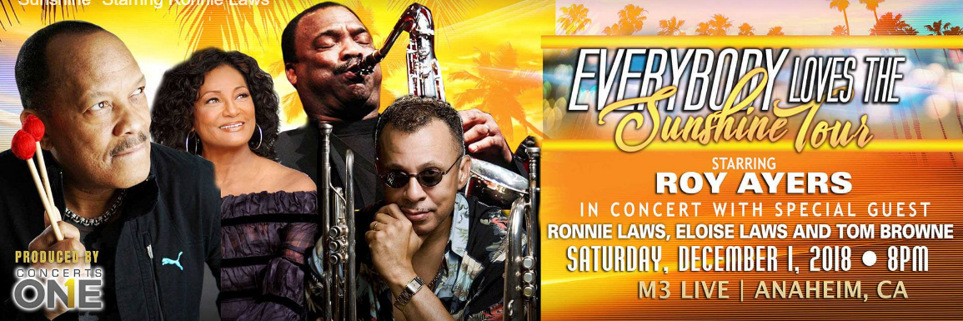

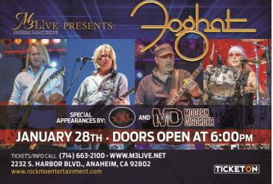
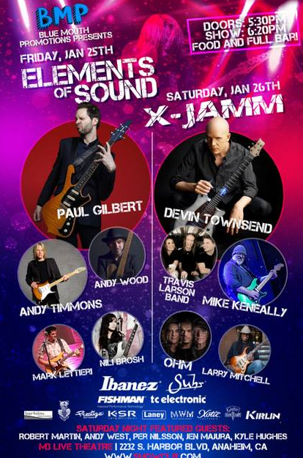


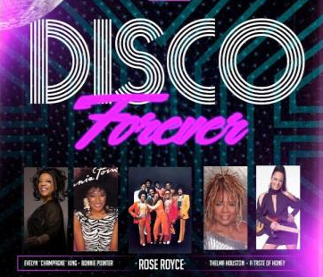

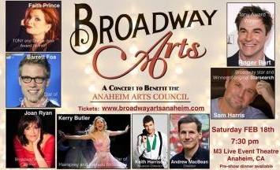
Past Events

